Slide 1
The Art of Leadership Club Leader's Day
GFWC Massachusetts
August 21, 2021

Slide 2
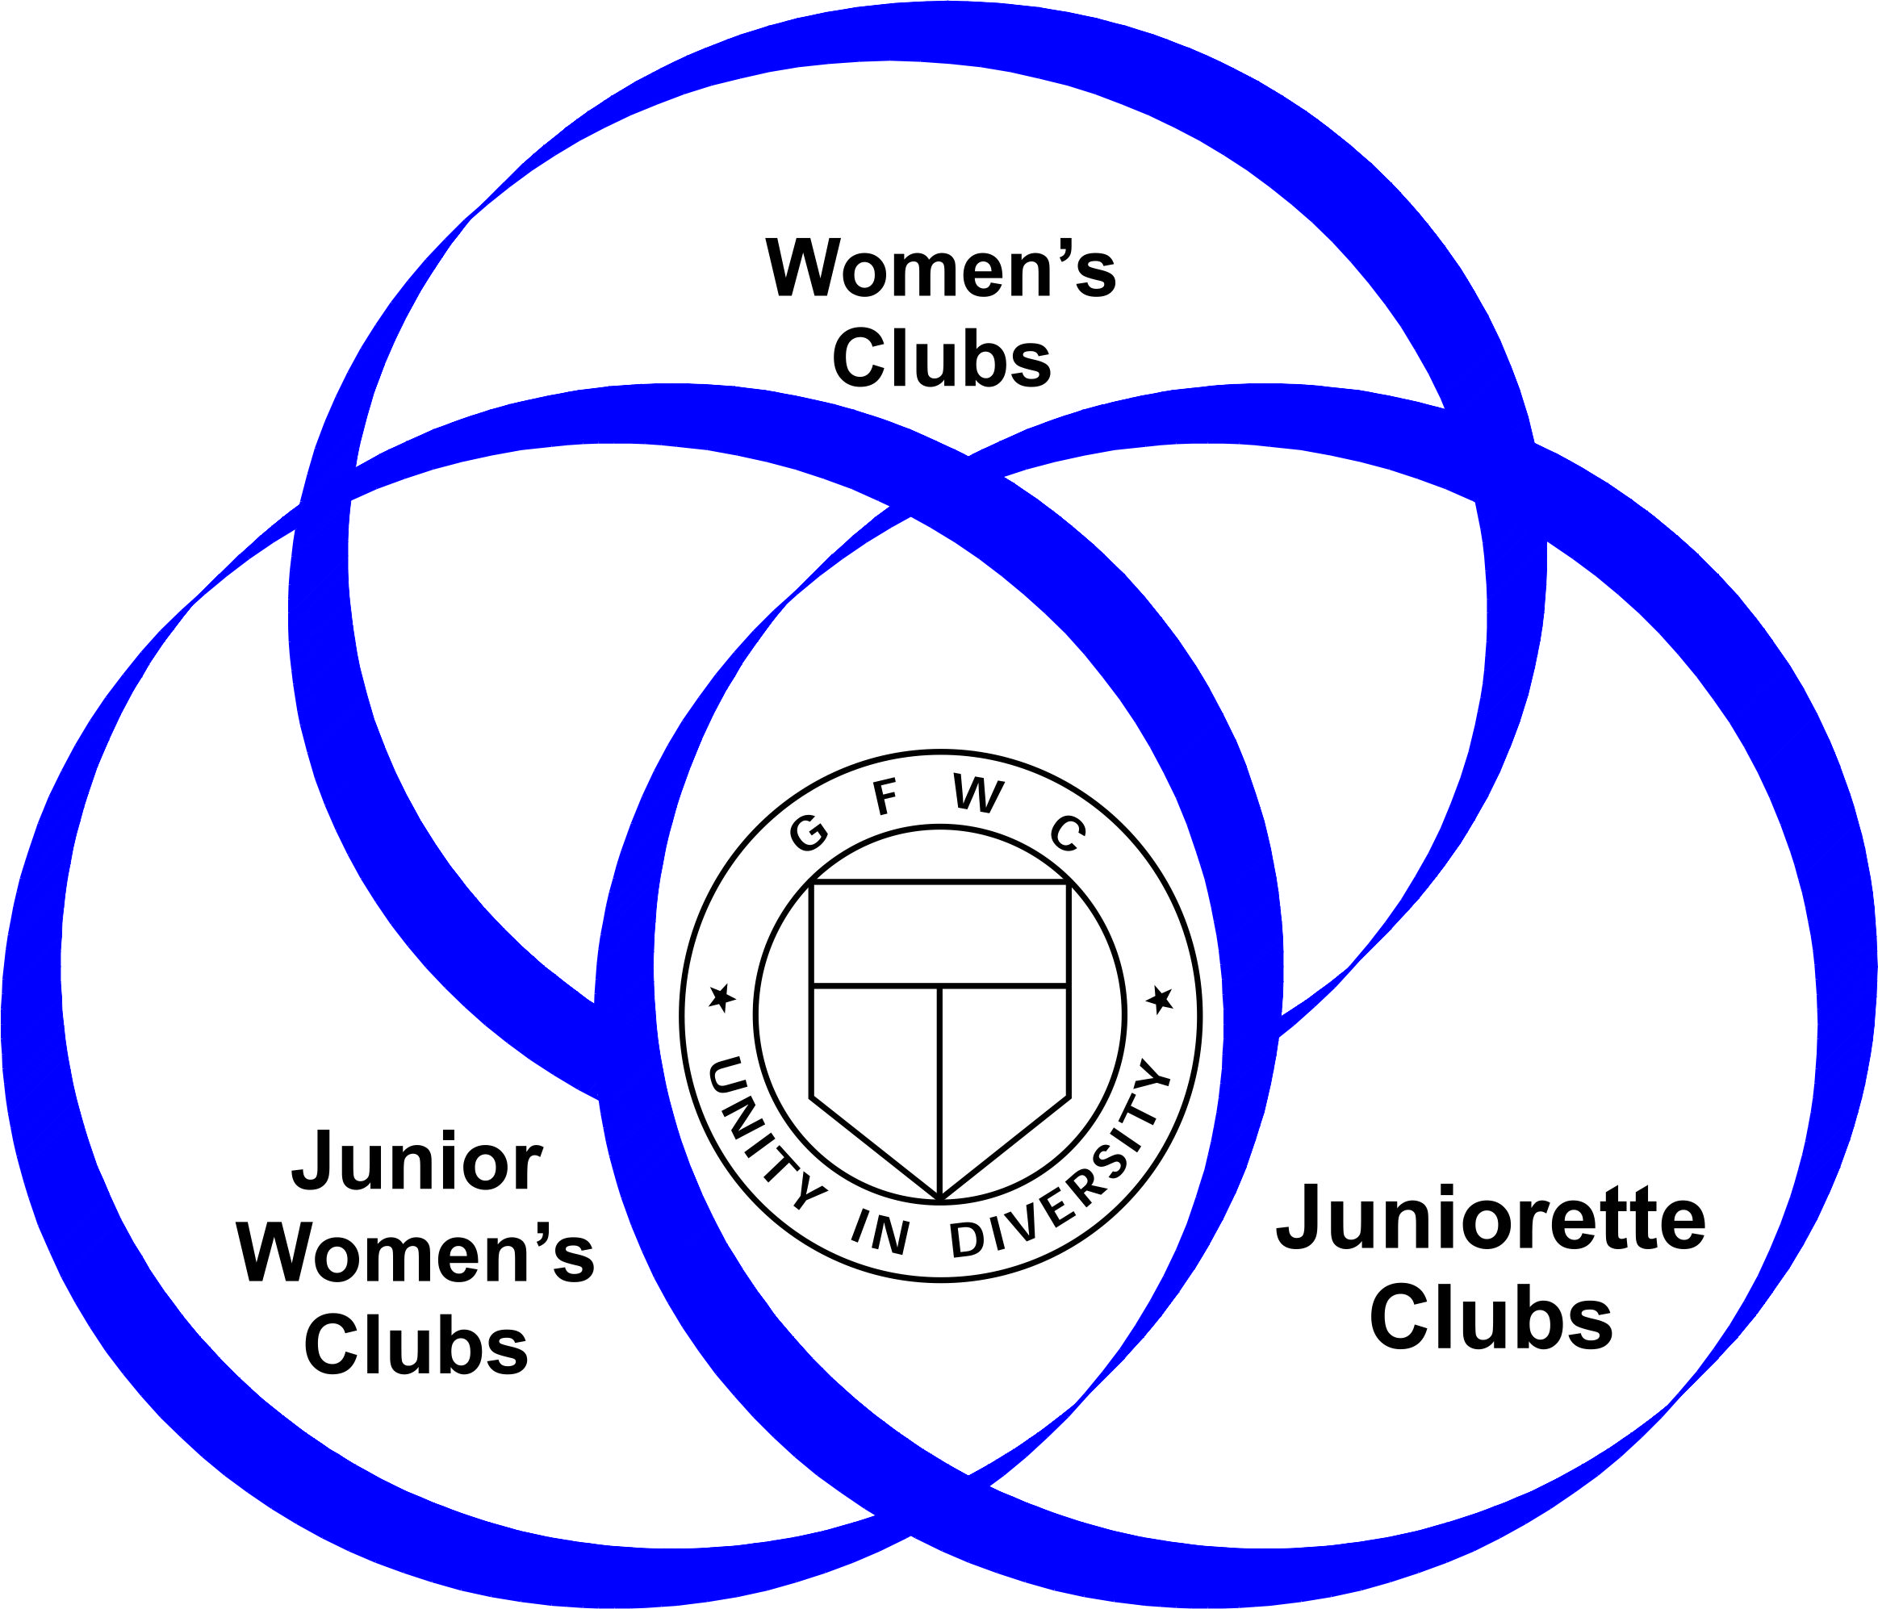
The Art of Painting ~ Portrait of our GFWC Massachusetts History Donna Shibley
GFWC Massachusetts History
Established in 1893 with Julia Ward Howe as the first State President
GFWC Massachusetts Impact
Woodlands (Memorial Forest) purchased in 1949 from the Wayside Inn
Headquarters’ building dedication in 1987
State President’s focus areas
Donations
Causes
The Future
GFWC Massachusetts Federation Living the Volunteer Spirit

Slide 3
The Art of Painting ~ Palette of Scholarships Lucille Barton
Use the website to find GFWC MA Scholarships
The deadline for all applications is March 1, 2022.
Last year a total of 133 applications were received and 19 scholarships with a total funding of $10,950.00 was awarded. In addition, four $1,000.00 scholarships were awarded by the Women’s Italian Club of Boston.
Club Presidents are asked to reach out to their membership and also to publicize what is available to Massachusetts residents.

Slide 4
The Art of Painting ~ Palette of Scholarships Lucille Barton
Boston City Federation Scholarship
Business Scholarship
Communication Disorder/Speech Therapy Scholarship Education-Teaching Scholarship
International Study Abroad Scholarship
Julia Ward Howe Scholarship.
Music Scholarship for an Undergraduate Major in Voice
Nickels for Notes Music Scholarship
Pennies for Art Scholarship
Women's Italian Club of Boston Scholarships (two)

Slide 5
The Art of Painting ~ Gallery of Scholarship Financial Opportunities Lynne Stader
INVESTING has allowed GFWC Massachusetts to award multiple Memorial Education Scholarships For Graduate Studies
In 2021: 15 applications, 9 interviewed and 6 scholarships of $5,000 were awarded.
Mental Health and Public Health are being repeated as focus fields of study for 2022 graduate scholarships. This can include:
High School Counselor
Substance Abuse or Trauma Counselor
Therapist in private practice
Epidemiology and Infectious Diseases
Health Administration
Environmental and Occupational Health
Help spread the word about these opportunities for financial assistance😊
posted on our GFWC MA website ~ due to Headquarters March 1st, 2022.

Slide 6
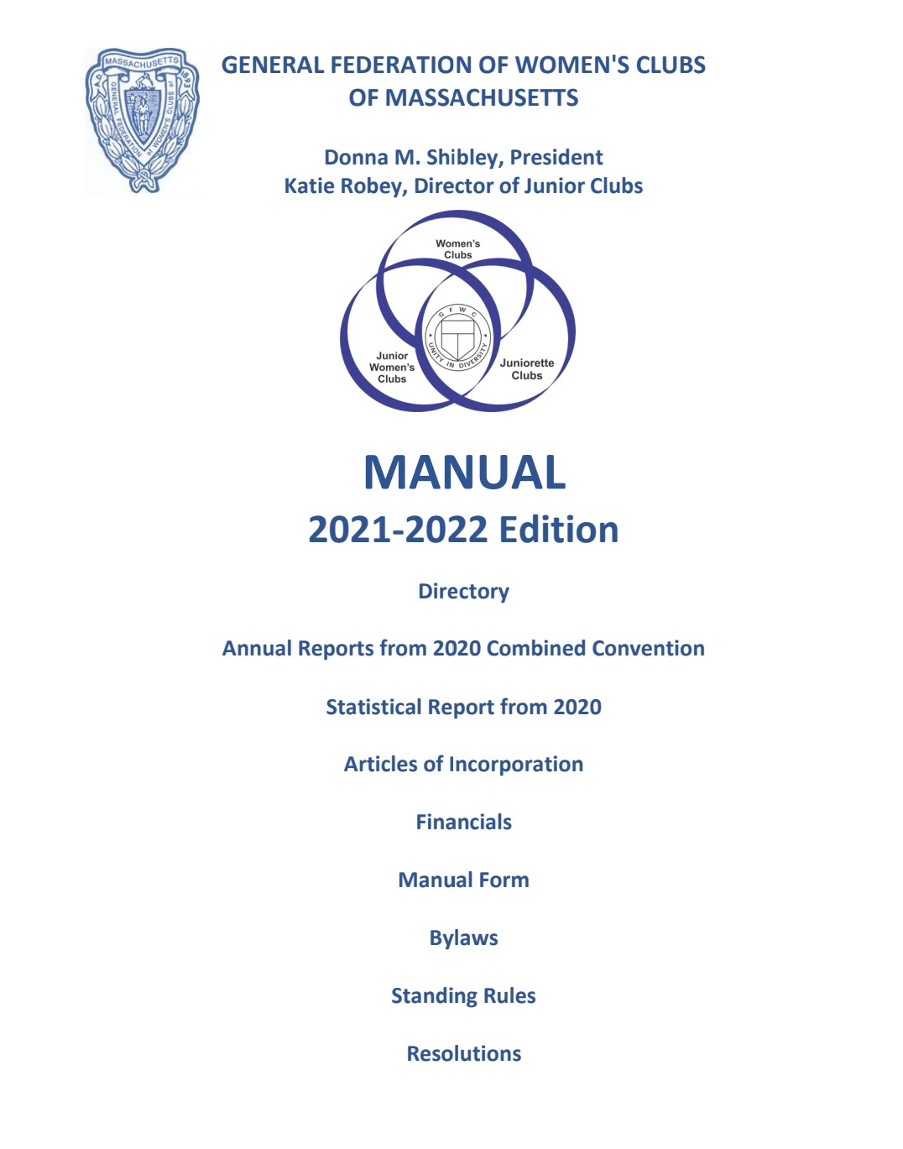
The Art of Theater ~ Your Playbook ~ The GFWC MA Manual Darlene Coutu
Setting the Scene ~ Where do I start?
The Scrip ~ Clubs and Club Officers
The Make-up of your Manual ~ Award-winning State Leaders
Rehearsal ~ Calendar
The Cast ~ State Board of Directors
Act I ~ Articles of Incorporation
Act II ~ ByLaws, Standing Rules, Resolutions
Off Broadway ~ GFWC
Curtains
THE END

Slide 7
The Art of Theater ~ Choreographing Your Club Fundraising Mary Ann Pierce
Ready for a challenge – get your DISCO on.
Desire to create enthusiasm and JAZZ it up?
Wish you had a sponsor to cover costs and TAP into other options
How to invite new members and add to your CHORUS LINE?
Want to have fun and RUMBA with your event?
Need funds to LINE UP your goals?

Slide 8
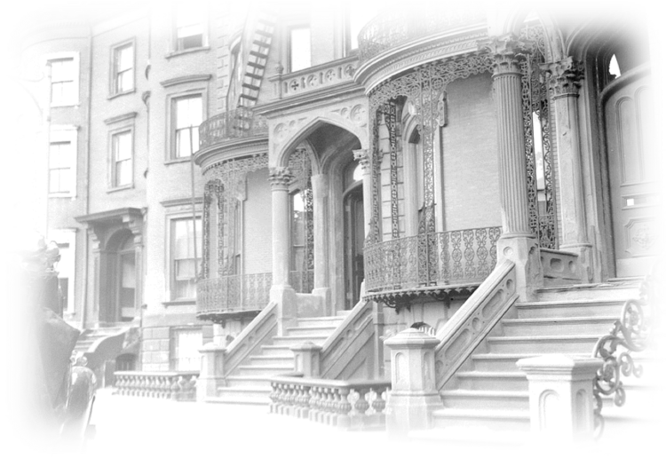
The Art of Architecture ~ Renovating the League of Women for Community Service Clubhouse Adrienne Benton and Kalimah Redd Knight
“The object shall be to undertake such work, educational, charitable, as will benefit the community, and to co-operate with other agencies working for the same end.” ~ Constitution of the League of Women for Community Service (1920)
Capital Campaign ~ The LWCS (The League) has received a matching grant from the Massachusetts Historical Commission to support the performance of an Existing Conditions and Feasibility Study for the restoration of 558 Massachusetts Ave. Spencer, Sullivan & Vogt is the architecture firm retained to perform the study. Upon completion of the study The League will begin their capital campaign to support the restoration of this historic building.
The League continues its civic and social activities and is positioned to continue its impact throughout the 21st century.

Slide 9
The Art of Architecture ~ Constructing our Women’s History and Resource Center (WHRC) History Laurie LaBrecque
Celebrates women leaders of the past.
Conserves the ongoing story of accomplishments of current individual women and group efforts – including those of your own club.
Supports the GFWC WHRC where one can find documents and stories of the women who have advanced the leadership and rights of us all.
Here’s what we can all do all the time:
Connect with, support and participate with your local Historical Society. Find out what resources they have which highlight women's history or a woman leader in your locale.
Encourage preservation of historic properties.
Support the MA GFWC Headquarters Building in Sudbury. Donate. Hold a meeting there.
Organize a club outing to an historic property, What role did women have in its history.
Work on your own club's history. Who were the founders and why did they start your club?
Start a document preserving your ongoing story. Celebrate your leaders, past and present.
Look through club records. Educate current members on impactful past projects.

Slide 10
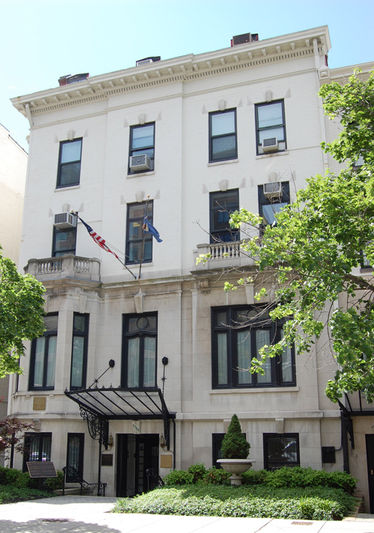
The Art of Architecture ~ Architecting GFWC Headquarters Katie Robey
1734 N Steet Washington, DC
Radford Family and the Markley Family
The Spite Room
General Nelson A. Miles
The White Family
Rooms of Interest
The Iron Gate Inn

Slide 11
The Art of Music ~ Singing Praises About Your Clubmembers Pat Furtado
Strengthen the bond to the club
Encourage retention of members
Nurture our club members
Acquaint with a new member survey
Assign a mentor or “big” sister
Appoint new members to a committee
Environment of your club: welcoming, friendly, inviting
Engage ask for suggestions and recommendations
Experience GFWC history and facts with members
Energize meetings to be convenient and productive

Slide 12
The Art of Music ~ Composing Your Club Reports Jen Nowak
Special Programs (SP):
Juniors’ Special Program: Advocates for Children
GFWC Signature Program: Domestic and Sexual Violence Awareness and Prevention
Community Service Programs (CSP):
Arts and Culture
Civic Engagement and Outreach
Environment
Education and Libraries
Health and Wellness
Advancement Plans (AP):
Communications and Public Relations
Fundraising and Development
Leadership
Legislation/Public Policy
Membership
Women’s History and Resource Center (WHRC)

Slide 13
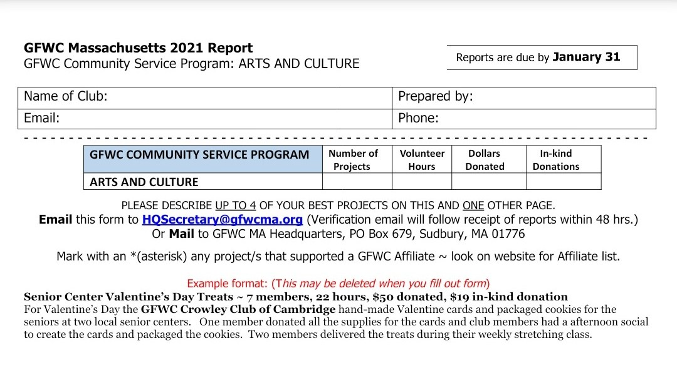
The Art of Music ~ Composing Your Club Reports Jen Nowak
Compile and Report your information on the GFWC MA Club Statistical Form
Add Narratives to give GFWC MA a better picture of your projects/programs
NO back up material (e.g., fliers, pictures) needed
Include information on the Affiliate Organizations ~ how to report this info
Shot@Life
St. Jude's Children's Research Hospital
Prevent Child Abuse America
Heifer International
HOBY - Hugh O'Brian Youth Leadership
March of Dimes
Operation Smile
UNICEF
Canine Companions

Slide 14
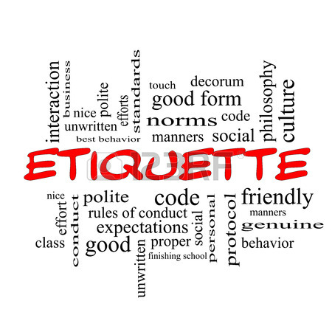
The Art of Cinema ~ Aerial Shot of Protocol Marisa Jablanski
GFWCMA
Why Do We Need Protocol?
Protocol includes all the courtesies extended by the host of an event to all attending. Even during casual meetings, good manners never go out of style and everyone should be treated with respect. Protocol gives us the rules to accomplish this.
How Can We Use Protocol in Our Club?
Arranging the head table
Inviting a special guest
General meeting etiquette

Slide 15
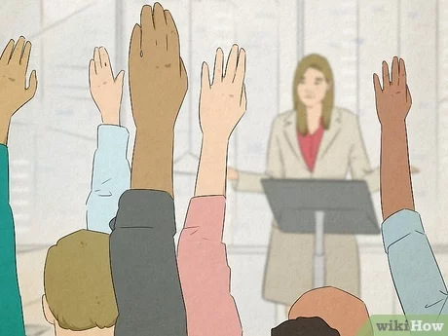
The Art of Cinema ~ Setting the Stage for Meetings from Shirley Gomes, presented by Donna Shibley
GFWCMA
How to make a motion:
I move… or The Education Committee moves… (state the motion). Formal: have the motion in writing to present to the chair. Second the motion (if motion is not presented by a committee) Chair restates the motion. Discussion. Vote. Announce results.
How amend a motion:
I move to amend (state the original motion). Second the amended motion to the original motion. Chair restates the amended motion. Discussion. Vote. Announce results. Now vote on the original motion as amended
Secretary report
Minutes are presented, ask members for corrections, then say “If there are no (further) corrections . . . (pause) . . . the minutes are approved as read/distributed/corrected.
Treasurer report
Report(s) are read, ask members if there are any questions, then say, “This (these) report(s) will be placed on file.”

Slide 16
The Art of Literature ~ Interpret your Bylaws and Standing Rules Terry Rouvalis
GFWC conducts its business by following Roberts Rules of Order, Newly Revised 12th Edition
What are Bylaws? ~ Rules adopted by an organization chiefly for the government of its members and the regulation of its affairs.
Examples: Name and address of organization, Membership requirements, Financial responsibilities
Creation and amendments to Bylaws need to follow a formal notification before being presented for adoption. ~ GFWC Massachusetts requires a 30-day written notice to all members before being presented for adoption at a State Meeting.
What are Standing Rules? ~ Standing rules establish specific rules for an organization's day-to-day conduct.
Examples: Rules for reviewing the Standing Rules, Listing of Board of Directors positions, Rules for conducting a meeting
Standing Rules can be amended or created informally. GFWC Massachusetts requires Standing Rules amendments be presented for adoption at Board of Director’s Meetings
Location: You can find GFWC MA Bylaws and Standing Rules in two places
HQ copy of the Manual - a printed copy of both are included in the HQ Manual and distributed to State Officers
GFWC MA Website - updates to the Bylaws and Standing Rules are posted to the website and available for printing

Slide 17
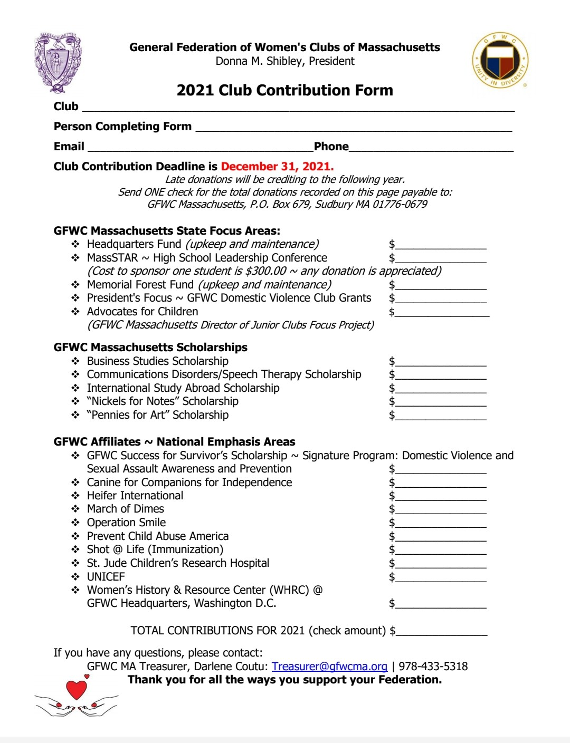
The Art of Sculpture ~ Casting your End of the Year Donations Donna Shibley
GFWC Massachusetts State Focus Areas
Headquarters Fund
Memorial Forest Fund
President’s Focus ~ GFWC Domestic Violence Club Grants
Director of Junior Clubs Focus ~ Advocates for Children
GFWC Massachusetts Scholarships
Scholarships funded by our clubs and clubmembers
GFWC Affiliates ~ National Emphasis Areas
Club Contribution Deadline is December 31, 2021

Slide 18
The Art of Sculpture ~ Sculpting the Next Administration from Sheila Shea, presented by Darlene Coutu
Endorsements for Candidates for Office for the 2022-2024 administration are due to Nominating Committee Chairman Sheila Shea
October 1, 2021 deadline.
Additional information can be found in the GFWC Massachusetts Bylaws, Article XI. Nominations and Elections
Located on the GFWC MA website at GFWCMA.org/Members/Governing Documents/GFWC MA Bylaws.
For further information, please contact Sheila at sheas1972@msn.com

Slide 19
The End

