Slide 1
General Federation of Women’s Clubs of Massachusetts
Do WE Have NEWS for YOU ~ Club Leaders Day
August 27, 2022
Moderator Terry Rouvalis,
GFWC MA 2nd Vice President
GFWC Massachusetts
Website: https://www.gfwcma.org/
FaceBook: https://www.facebook.com/GFWCMA

Slide 2
NEWS PAGE Flash! Latest NEWS regarding GFWC MA Programs GFWC Contests and GFWC Special Programs
President’s Focus Area: Mental Health
Memorial Education Scholarship
GFWC MA Scholarships
Photography and Writing Contests
Community Impact Program
GFWC Signature Program: Domestic and Sexual Violence Awareness and Prevention
GFWC Juniors’ Special Program: Advocates for Children
GFWC MA ~ Do WE Have News for YOU
Club Leaders Day ~ August 27, 2022

Slide 3
EDITORIAL PAGE Tips about GFWC and GFWC MA Community Service Programs (CSP) and Advancement Plans (AP)
Arts & Culture
Civic Engagement and Outreach
Education and Libraries and ESO
Environment
Health and Wellness
Legislation/Public Policy
Leadership
Membership
Women’s History and Resource Center (WHRC)

Slide 4
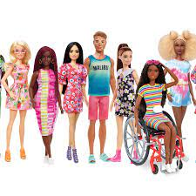
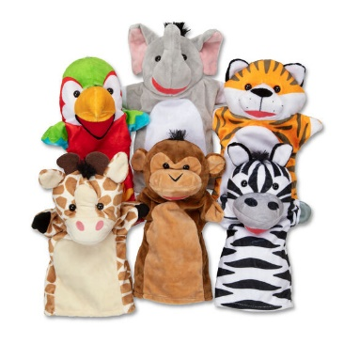
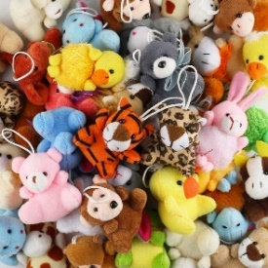
ARTS AND CULTURE Bernadette Bennett, Chairman | bbennett@bu.edu | 781.690.2824
Chairman Project: A Friend and a Book Just for YOU
Arts and Culture helping children in Domestic Violence Shelters. Contact Bernadette for help as needed.
What you will need:
a children’s book (new or very gently used)
a new doll, a new stuffed toy, or a new hand puppet
make an outfit for your doll/stuffed toy/puppet to wear representing a character in the book
Please donate to a local Domestic Violence Shelter
Report what was donated

Slide 5
CLUB OPERATIONS PAGE A Well-Run Organization Uses These
Bylaws and Standing Rules
Resolutions
Club Reporting
Parliamentary procedure
Finances
Fundraising

Slide 6
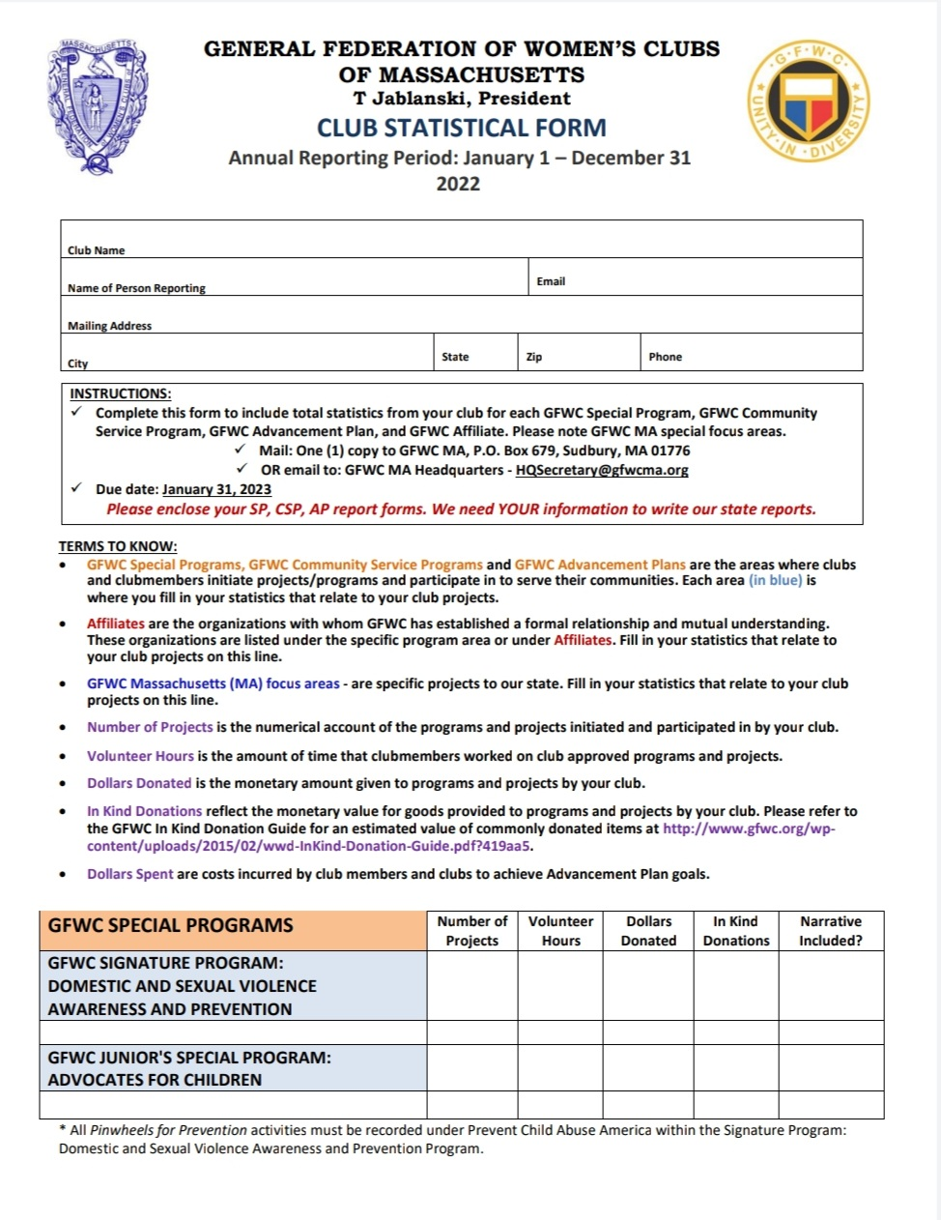
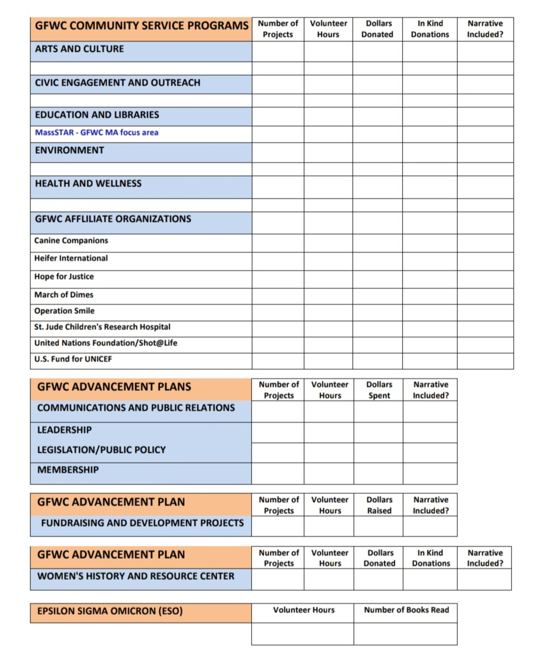
REPORTING

Slide 7
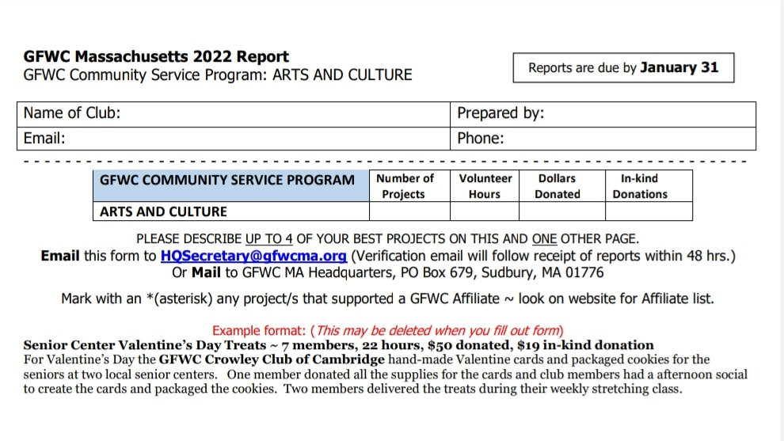
REPORTING

Slide 8
COMMUNICATIONS PAGE Getting the News Out
TOPICS
Website (gfwcma.org)
GFWC MA Manual Directory
State Meetings
Region Conferences

Slide 9
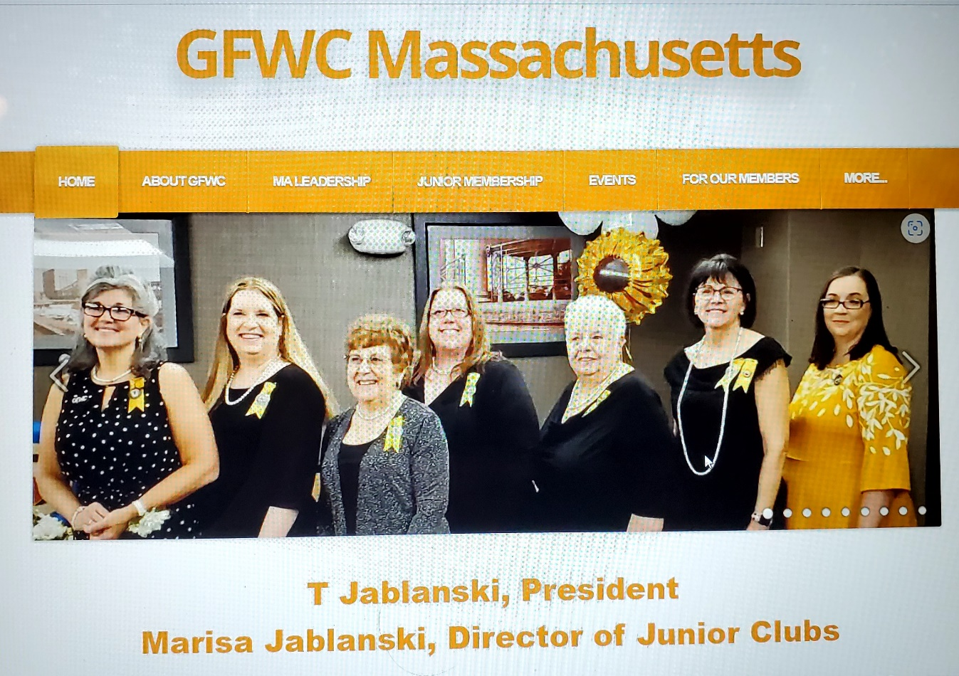
GFWC MA Website
https://www.gfwcma.org/

Slide 10
Thank YOU
For attending
Do WE Have News for
YOU ~ Club Leaders Day

