Slide 1
GFWC Massachusetts
A proud member of the
General Federation of Women’s Clubs
Notes:
GFWC and GFWC Massachusetts membership
As a member of your local club, you are also a member of the GFWC Massachusetts Federation of Women’s Clubs and the General Federation of Women’s Clubs or GFWC.

Slide 2
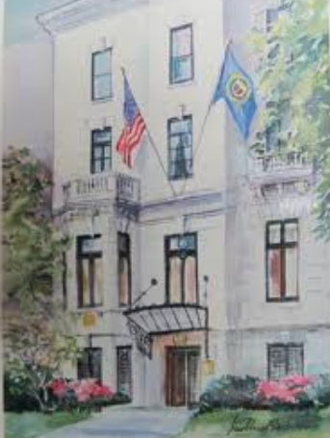
General Federation of Women’s Clubs
Headquarters – Washington, DC
#UnityInDiversity #LivingTheVolunteerSpirit
Notes:
GFWC Headquarters
Our International headquarters administrative offices are located at 1734 N Street NW, Washington, DC 20036
This is the home of the GFWC International President during her two-year term.
Our taglines and motto are: Unity in Diversity and Living the Volunteer Spirit.

Slide 3
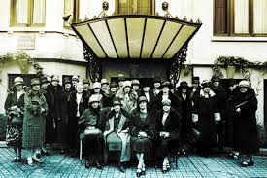
GFWC
Women’s History & Resource Center
Notes:
GFWC Women’s History and Resource Center
The GFWC Women’s History and Resource Center is also located in Washington, DC. The WHRC collects, preserves, interprets, and promotes the history of the GFWC and women volunteers. The WHRC documents the social and political contributions of GFWC clubwomen from 1890 to the present through the GFWC archives, related special collections, and publications.

Slide 4
GFWC was founded in 1890 by
Jane Cunningham Croly
“Is it possible that women may have a life of their own, may learn to know and honor each other, may find solace in companionship,
and lose sight of small troubles in large aims?”
Notes:
History of GFWC
GFWC has a rich history since its founding in 1890.
In 1868, Jennie June Croly, an accomplished New York newspaperwoman, was denied admittance to a
Banquet honoring Charles Dickens at the all-male New York Press Club, simply because she was a woman.
Outraged, she was determined to organize a club for women. The General Federation was founded in 1890,
with the motto, “Unity in Diversity.”
This group of women has grown into one of the largest organizations of volunteer women in the world.
GFWC has nearly 80,000 members in affiliated clubs in every state, the District of Columbia, and more than a dozen countries.

Slide 5
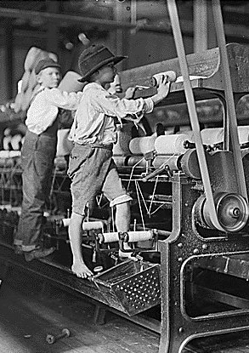
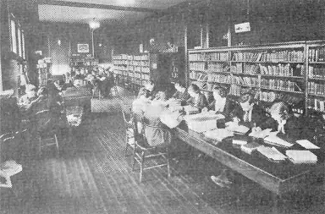
GFWC
Established 75% of
the Nation’s Libraries
Passage of the Child Labor Laws
Notes:
GFWC – Libraries, Food and Drug Act and Child Labor Laws
GFWC was instrumental in establishing most of the nation’s libraries and helped to pass the Pure Food
and Drug Act and the first child labor laws.

Slide 6
GFWC President
GFWC Executive Committee
President-elect, 1st Vice President, 2nd Vice President, Secretary,
Treasurer, Director of Junior Clubs, Director-elect of Junior Clubs
President-
elect
First Vice
President
Second Vice
President
Treasurer
Director of
Junior Clubs
Region Presidents
State
Presidents
Special and Community
Service
Program and Advancement Plan
Chairmen
Budget and Finance Committee
State Directors of Junior Clubs
Information Flow Chart
Notes:
Flow Chart of Information
This chart shows how information passes from GFWC to the regions and state federations.

Slide 7
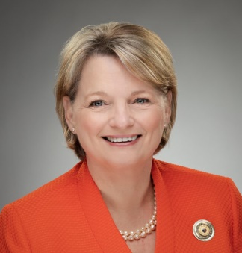
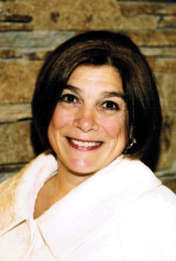
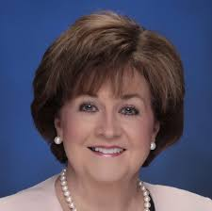
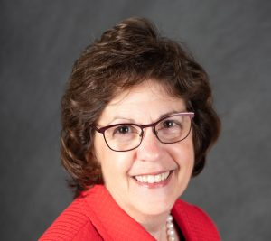
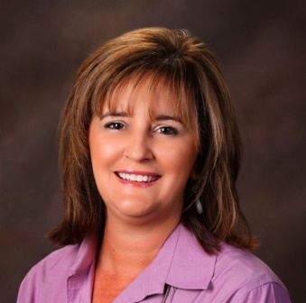
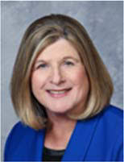
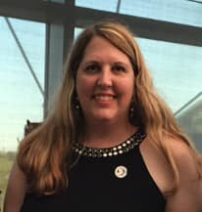
GFWC
2020-2022 Executive Committee
Marian St Clair President
Deb Strahanoski
President-elect
Suellen Brazil
1st Vice President
Wendy Carriker
2nd Vice President
Jolie Frankfurth
Secretary
Kristina Higbee Director of Junior Clubs
Mary Beth Williams Treasurer
Notes:
GFWC International officers are elected by voting members at the GFWC annual convention in the even-numbered years. The term of office is two years.

Slide 8
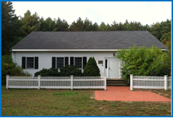
GFWC Massachusetts
Headquarters – Sudbury, MA
Federated in 1894 127 years of volunteer service
Notes:
GFWC Massachusetts Headquarters
Our state headquarters is located in Sudbury, Massachusetts.
The office is the repository of the organization’s archives dating to its 1893 inception and establishment in 1984. Furnishings and art objects have been donated by clubs, members and businesses.
The GFWC Massachusetts President and the Executive Committee members oversee the operation of our state Federation. Our state membership is over 1385 members.

Slide 9
GFWC Massachusetts President
GFWC Massachusetts Executive Committee
1st Vice President, 2nd Vice President, Recording Secretary,
Corresponding Secretary, Treasurer, Director of Junior Clubs
President
First Vice
President
Second Vice
President
Director of
Junior Clubs
Treasurer
Board of Directors
State
Committee
Chairmen
Dean of
Chairmen
Club
Treasurers
Jr. Executive
Committee
Club
Presidents
Junior Club
Presidents
Finance Committee
Junior Club Members
General Club Members
Juniorettes
Information Flow Chart
Notes:
Flow Chart of Information
This chart shows how information passes from the GFWC Massachusetts President, Director of Junior Clubs and Executive Committee members
to the club officers and the general membership.

Slide 10
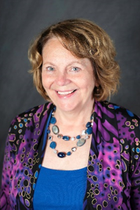
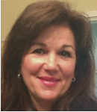
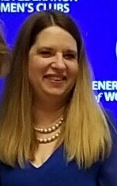
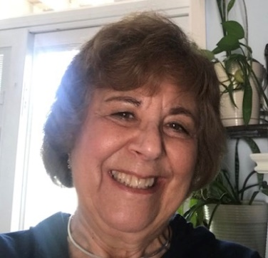
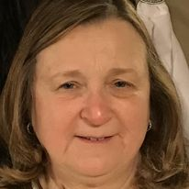
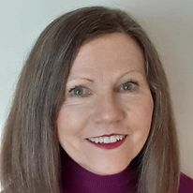
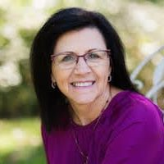
2020-2022
Executive Committee
Donna Shibley
GFWC Massachusetts President
INSERT OFFICER PHOTO
INSERT OFFICER PHOTO
INSERT OFFICER PHOTO
T Jablanski
1st Vice President
Jen Nowak
2nd Vice President
Terry Rouvalis
Recording Secretary
INSERT OFFICER PHOTO
INSERT OFFICER PHOTO
INSERT OFFICER PHOTO
Donna Canavan
Corresponding Secretary
Darlene Coutu
Treasurer
Katie Robey
Director of Junior Clubs
Notes:
GFWC Massachusetts Officers are elected by voting members at the GFWC Annual Convention in the even-numbered years. The term of office is two years.

Slide 11
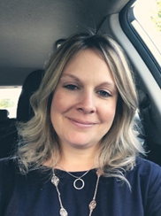
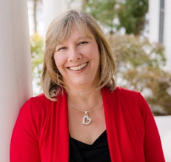
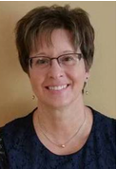
2020-2022 Junior
Executive Committee
Katie Robey
GFWC Massachusetts Director of Junior Clubs
INSERT OFFICER PHOTO
INSERT OFFICER PHOTO
Marisa Jablanski
Assistant Director of Junior Clubs
Beth McKeon
Recording Secretary
Kathleen Goneau
Corresponding Secretary
Nancy Coughlin
Treasurer
Notes:
GFWC Massachusetts Junior Officers are elected by voting members at the GFWC Annual Convention in the even-numbered years. The term of office is two years.

Slide 12
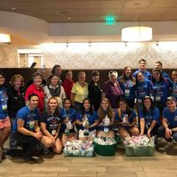
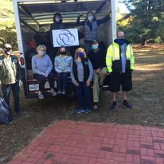
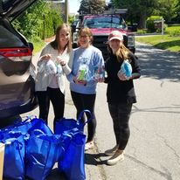
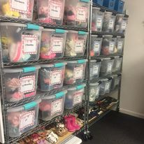
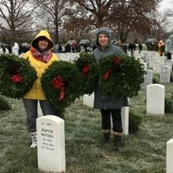
GFWC Massachusetts
Supports and Volunteers
MassSTAR~LaSalle College
Savers Collection – Sudbury, MA
Juniorettes collecting toiletries
Project New Hope – Westfield, MA
Wreaths Across America – Arlington, VA

Slide 13
GFWC Massachusetts
Community Service Programs
Arts & Culture
Health & Wellness
Civic Engagement & Outreach
Environment
Education & Libraries

Slide 14
GFWC Massachusetts 2020-2022
Director’s Project
Advocates for Children
INSERT PRESIDENT’S PROJECT LOGO / INFORMATION
President’s Project
Domestic and Sexual Violence Awareness and Prevention

Slide 15
GFWC Massachusetts by the numbers
25 Women’s Clubs, 18 Junior Women’s Clubs, 1 Juniorette Club, 4 Associate Clubs, 3 District Clubs
Over 1385 members
Almost 47,000 hours volunteer service in 2019
Over $425,000 in community grants, scholarships, monetary & in-kind donations in 2019
Over 1350 community service projects completed in 2019

Slide 16
Membership Classifications
Women’s Clubs
Junior Women’s Clubs
Juniorette Clubs
Ages 12- 18

Slide 17
GFWC Membership Benefits
Community
Service
Personal Growth
and Development
Fellowship
and Friendship
Notes:
Member Benefits
The three most common benefits in belonging to a federated club are: community service, personal growth and development, and fellowship and friendships.
As a civic organization, we are able to pinpoint our community needs and strive to meet those needs.
At our club meetings, we grow by working together toward common goals. Our members are taught leadership skills and techniques that help them in all aspects of their lives.
Camaraderie is an important benefit of belonging to a federated club. We share and make friends as we make a difference in our communities.

Slide 18
Membership
Responsibilities
Attend regular meetings
Participate in community service and
fund raising events
Pay club dues
Help membership grow

Slide 19
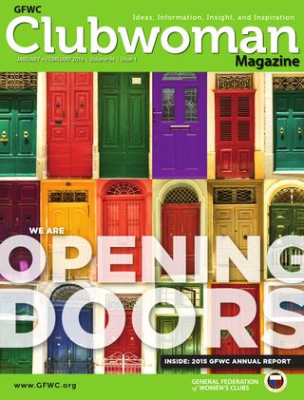
Sharing our message
GFWC
GFWC Massachusetts
Clubwoman Magazine
News & Notes
Federation Topics
The BEAT of the Federation
Notes:
Sharing our message
The GFWC Clubwoman Magazine is published quarterly by GFWC headquarters and provides a link to all clubwomen around the world. It is available by subscription only. GFWC News & Notes is a monthly electronic newsletter published by GFWC. It is available by email and on the website.

Slide 20
Keeping it Social
gfwc.org
gfwcma.org
gfwcmajuniors.org
Notes:
Keeping it social (social media)
The GFWC HQ website contains the history and mission of the GFWC, information on events and meetings, a member center, publications, and a link to the Women’s History and Resource Center.
The GFWC Massachusetts and GFWC Massachusetts Junior Membership website are maintained by the GFWC Massachusetts Webmaster and provides up-to-date information on all state federation activities.
GFWC, GFWC Massachusetts and GFWC Massachusetts Junior Membership have Facebook pages, Instagram and You Tube. All members are invited to follow them!

Slide 21
Credits
This presentation was originally designed by the GFWC Florida Membership Committee. The GFWC Florida Membership Committee and GFWC Membership Committee have given permission for the presentation to
be modified for use by all states.
We are better together!
GFWC Massachusetts
245 Dutton Road | PO Box 679
Sudbury, MA 01776

